Slide 1
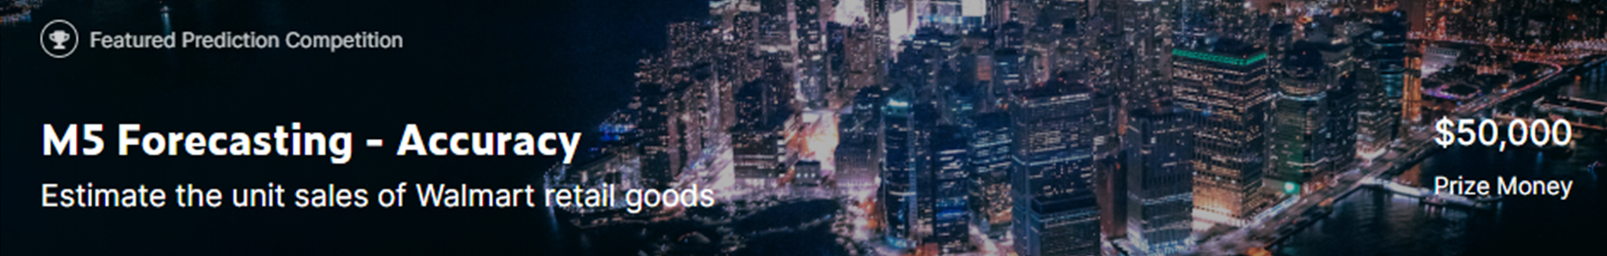
Kaggle M5 Forecasting – Accuracy 4th place solution
Masanori Miyahara <monsaraida@gmail.com>

Slide 2
Agenda
Background
Timeline
My approach
Solution
Overview
Features
Model
Validation
Summmary

Slide 3
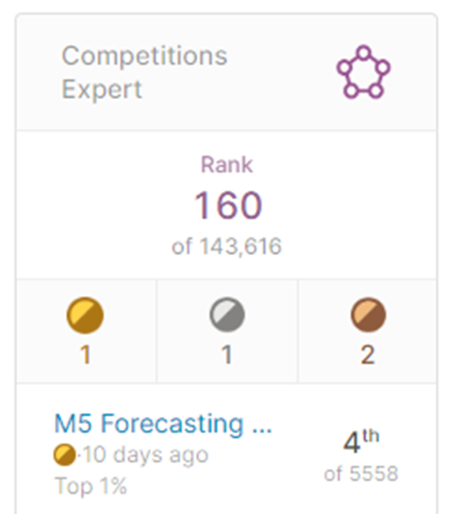

Background
I got my master’s degree in CS
I work as software engineer in a Japanese company
Kaggle is my personal activity
I joined Kaggle 1.5 years ago
https://www.kaggle.com/monsaraida

Slide 4
Timeline
Mar. 3rd
M5 accuracy competition launched
- I understood the data and evaluation metrics
- I created a baseline model
- I tried to make a stable validation method
- However, I realized that the validation scores varied significantly over the period
- I thought there was a mistake in my code
- Debugging, debugging and debugging…
Jun. 1st
Full training labels released
- I confirmed that my code is correct with newly released labels
- Therefore, I was strongly convinced that this competition would be very difficult
- I thought it would be impossible to build a model with high accuracy
- I decided to give up on trying to get a high ranking in the competition
- Instead of it, I decided to try to build a "practical" solution
Jun. 30th
M5 accuracy competition finished
- I was expecting my practical solution to be in the Top 10%
- The result was 4th place, I was very surprised

Slide 5
My approach : “Be practical”
Not to use post processing, multiplier and leaks
In practice, it is not possible to utilize such information
Not to care about official evaluation metrics (WRMSSE)
I thought WRMSSE is too difficult to understand for actual users
Not to use complex and recursive features
Just use general features that can be applied to any practical tasks
Recursive features lead to error accumulation (=risky)
Not to use computation resources too much
Single model (LightGBM only, no stacking, no blending)
Memory efficiency (model for each store and week)

Slide 6
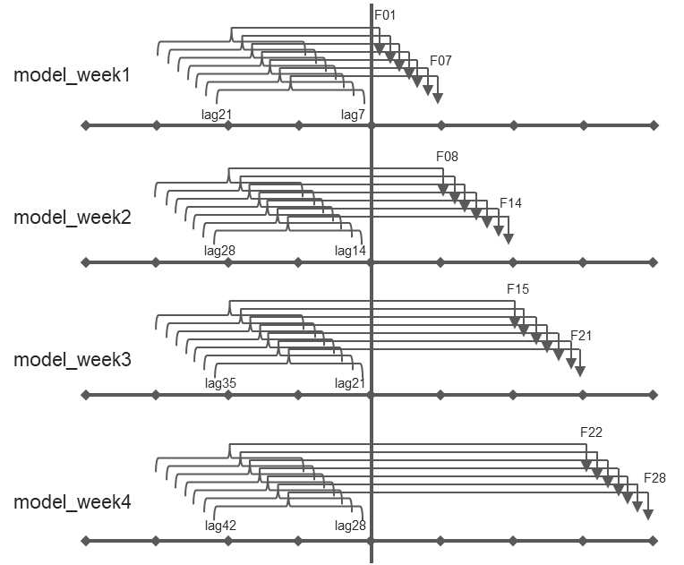
M5 Forecasting – Accuracy : 4th place solution
Features
10 stores
x
4 weeks
=
40 LightGBM models
- objective=tweedie
- no early stopping
Sales features
- sales_lag_{s|s+1|…|s+14}
- rolling_mean_{7|14|30|60|180}
- rolling_std_{7|14|30|60|180}
- release
store=CA_1
model_week1
model_week2
store=CA_2
Practical/Simple solution
- no blending/stacking
- no recursive modeling
- no postprocessing/multiplier
model_week3
Calendar features
- tm_{d|dw|w|w_end|wm|m|y}
- moon
- event_name_{1|2}
- event_type_{1|2}
- snap_{CA|TX|WI}
store=CA_3
model_week4
store=CA_4
store=TX_1
Weekly models
Price features
- price_{max|mean|min}
- price_{std|norm|nunique}
- price_cent_{max|min}
- price_momentum_{d|m|y}
store=TX_2
store=TX_3
store=WI_1
model_week1
Id features
- item_id, cat_id, dept_id
- enc_item_id_{mean|std}
- enc_cat_id_{mean|std}
- enc_dept_id_{mean|std}
store=WI_2
model_week2
store=WI_3
model_week3
model_week4

Slide 7
Weekly models
F01
model_week1
F07
lag21
lag7
F08
model_week2
F14
lag28
lag14
F15
F21
model_week3
lag35
lag21
F22
F28
model_week4
lag42
lag28

Slide 8
Features
Sales features
sales_lag_{s|s+1|…|s+14}
s={7, 14, 21, 28}
rolling_mean_{7|14|30|60|180}
rolling_std_{7|14|30|60|180}
release
Calendar features
tm_{d|dw|w|w_end|wm|m|y}
moon
event_name_{1|2}
event_type_{1|2}
snap_{CA|TX|WI}
Price features
sell_price, sell_price_cent
price_{max|mean|min|std|norm}
price_nunique, item_nunique
price_cent_{max|min}
price_momentum_{d|m|y}
Id features
item_id, cat_id, dept_id
enc_item_id_{mean|std}
enc_cat_id_{mean|std}
enc_dept_id_{mean|std}

Slide 9
Feature importance

Slide 10
Validation
fold_id | d | date | dow | data
 | 1 | 2011-01-29 | Sat | Train
 | ... | ... | ... | Train
 | ... | ... | ... | Train
1577 | 1578 | 2015-05-25 | Mon | Train
1577 | ... | ... | ... | Train
1577 | 1605 | 2015-06-21 | Sun | Train
 | ... | ... | ... | Train
 | ... | ... | ... | Train
1829 | 1830 | 2016-02-01 | Mon | Train
1829 | ... | ... | ... | Train
1829 | 1857 | 2016-02-28 | Sun | Train
1857 | 1858 | 2016-02-29 | Mon | Train
1857 | ... | ... | ... | Train
1857 | 1885 | 2016-03-27 | Sun | Train
1885 | 1886 | 2016-03-28 | Mon | Train
1885 | ... | ... | ... | Train
1885 | 1913 | 2016-04-24 | Sun | Train
1913 | 1914 | 2016-04-25 | Mon | Public LB
1913 | ... | ... | ... | Public LB
1913 | 1941 | 2016-05-22 | Sun | Public LB
1941 | 1942 | 2016-05-23 | Mon | Private LB
1941 | ... | ... | ... | Private LB
1941 | 1969 | 2016-06-19 | Sun | Private LB
WRMSSE
Private LB
(4th)
fold_id

Slide 11
Summary
My approach was “Be practical”
I was not aiming for the high ranking
My solution was very simple
Nothing special
Why did I win?
Correctly recognized the difficulty of the problem
Kept my solution simply and practically
Learnt many insights from community
(Had a great good luck)

Slide 12
Appendix: Excellent notebooks and discussions
[Notebooks]
https://www.kaggle.com/kyakovlev/m5-simple-fe
https://www.kaggle.com/kyakovlev/m5-lags-features
https://www.kaggle.com/kyakovlev/m5-custom-features
https://www.kaggle.com/kyakovlev/m5-three-shades-of-dark-darker-magic
https://www.kaggle.com/dhananjay3/wrmsse-evaluator-with-extra-features
[Discussions]
Few thoughts about M5 competition
https://www.kaggle.com/c/m5-forecasting-accuracy/discussion/138881
Evaluation metric
https://www.kaggle.com/c/m5-forecasting-accuracy/discussion/133834
Three shades of Dark
https://www.kaggle.com/c/m5-forecasting-accuracy/discussion/144067
Moon Phase. Odd, yet helpful feature.
https://www.kaggle.com/c/m5-forecasting-accuracy/discussion/154776

